Slide 1
Creating the Work Breakdown Structure (WBS)
A WBS is a deliverable-oriented grouping of the work involved in a project that defines the total scope of the project
WBS is a foundation document that provides the basis for planning and managing project schedules, costs, resources, and changes
Decomposition is subdividing project deliverables into smaller pieces
A work package is a task at the lowest level of the WBS
Information Technology Project Management, Fifth Edition, Copyright 2007

Slide 2
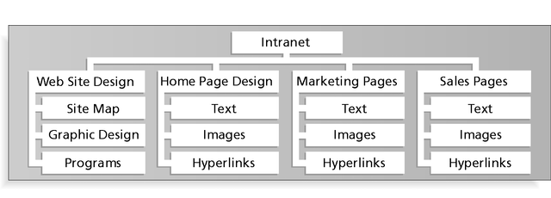
Figure 5-2: Sample Intranet WBS
Organized by Product
Information Technology Project Management, Fifth Edition, Copyright 2007

Slide 3
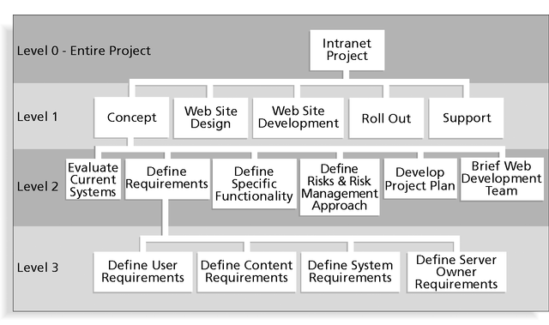
Figure 5-3: Sample Intranet WBS
Organized by Phase
Information Technology Project Management, Fifth Edition, Copyright 2007

Slide 4
Table 5-4: Intranet WBS in Tabular Form
1.0 Concept
1.1 Evaluate current systems
1.2 Define Requirements
1.2.1 Define user requirements
1.2.2 Define content requirements
1.2.3 Define system requirements
1.2.4 Define server owner requirements
1.3 Define specific functionality
1.4 Define risks and risk management approach
1.5 Develop project plan
1.6 Brief Web development team
2.0 Web Site Design
3.0 Web Site Development
4.0 Roll Out
5.0 Support
Information Technology Project Management, Fifth Edition, Copyright 2007

Slide 5
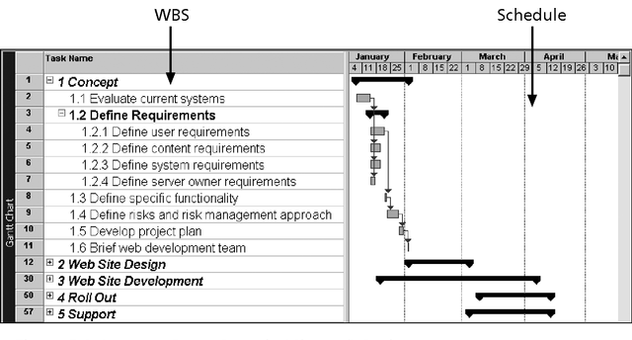
Figure 5-4: Intranet WBS and Gantt Chart in Microsoft Project
Information Technology Project Management, Fifth Edition, Copyright 2007

Slide 6
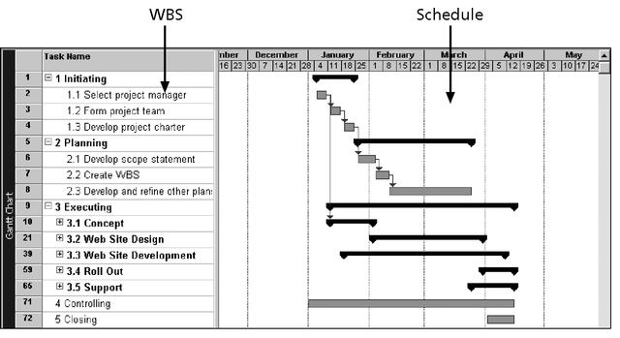
Figure 5-5: Intranet Gantt Chart Organized by Project Management Process Groups
Information Technology Project Management, Fifth Edition, Copyright 2007

Slide 7
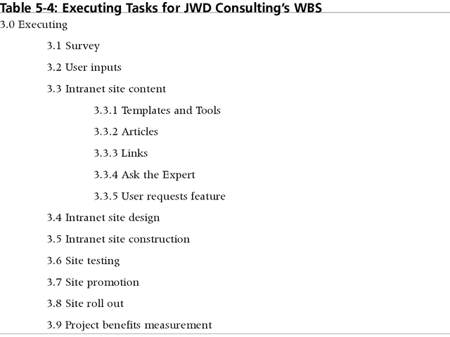
Table 5-5: Executing Tasks for JWD Consulting’s WBS
Information Technology Project Management, Fifth Edition, Copyright 2007

Slide 8
Approaches to Developing WBSs
Using guidelines: some organizations, like the DOD, provide guidelines for preparing WBSs
The analogy approach: review WBSs of similar projects and tailor to your project
The top-down approach: start with the largest items of the project and break them down
The bottom-up approach: start with the specific tasks and roll them up
Mind-mapping approach: mind mapping is a technique that uses branches radiating out from a core idea to structure thoughts and ideas
Information Technology Project Management, Fifth Edition, Copyright 2007

Slide 9
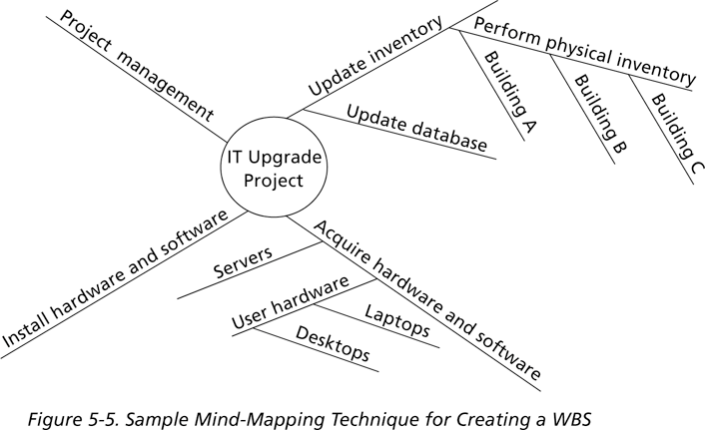
Figure 5-6: Sample Mind-Mapping Approach for Creating a WBS
Information Technology Project Management, Fifth Edition, Copyright 2007

Slide 10
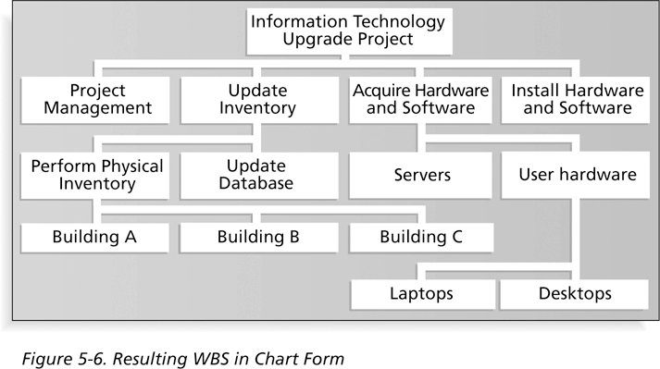
Figure 5-7: Resulting WBS in Chart Form
Information Technology Project Management, Fifth Edition, Copyright 2007

Slide 11
The WBS Dictionary and Scope Baseline
Many WBS tasks are vague and must be explained more so people know what to do and can estimate how long it will take and what it will cost to do the work
A WBS dictionary is a document that describes detailed information about each WBS item
The approved project scope statement and its WBS and WBS dictionary form the scope baseline, which is used to measure performance in meeting project scope goals
Information Technology Project Management, Fifth Edition, Copyright 2007

Slide 12
Advice for Creating a WBS and WBS Dictionary*
A unit of work should appear at only one place in the WBS
The work content of a WBS item is the sum of the WBS items below it
A WBS item is the responsibility of only one individual, even though many people may be working on it
The WBS must be consistent with the way in which work is actually going to be performed; it should serve the project team first, and other purposes only if practical
*Cleland, David I. Project Management: Strategic Design and Implementation, 1994
Information Technology Project Management, Fifth Edition, Copyright 2007

Slide 13
Advice for Creating a WBS and WBS Dictionary (continued)*
Project team members should be involved in developing the WBS to ensure consistency and buy-in
Each WBS item must be documented in a WBS dictionary to ensure accurate understanding of the scope of work included and not included in that item
The WBS must be a flexible tool to accommodate inevitable changes while properly maintaining control of the work content in the project according to the scope statement
*Cleland, David I. Project Management: Strategic Design and Implementation, 1994
Information Technology Project Management, Fifth Edition, Copyright 2007

Slide 14
What Went Wrong?
A project scope that is too broad and grandiose can cause severe problems
  Scope creep and an overemphasis on technology for technology’s sake resulted in the bankruptcy of a large pharmaceutical firm, Texas-based FoxMeyer Drug
  In 2001, McDonald’s fast-food chain initiated a project to create an intranet that would connect its headquarters with all of its restaurants to provide detailed operational information in real time; after spending $170 million on consultants and initial implementation planning, McDonald’s realized that the project was too much to handle and terminated it
Information Technology Project Management, Fifth Edition, Copyright 2007

Slide 15
Scope Verification
It is very difficult to create a good scope statement and WBS for a project
It is even more difficult to verify project scope and minimize scope changes
Scope verification involves formal acceptance of the completed project scope by the stakeholders
Acceptance is often achieved by a customer inspection and then sign-off on key deliverables
Information Technology Project Management, Fifth Edition, Copyright 2007

Slide 16
Scope Control
Scope control involves controlling changes to the project scope
Goals of scope control are to:
  Influence the factors that cause scope changes
  Assure changes are processed according to procedures developed as part of integrated change control
  Manage changes when they occur
Variance is the difference between planned and actual performance
Information Technology Project Management, Fifth Edition, Copyright 2007

Slide 17
Best Practices for Avoiding Scope Problems
1. Keep the scope realistic: Don’t make projects so large that they can’t be completed; break large projects down into a series of smaller ones
2. Involve users in project scope management: Assign key users to the project team and give them ownership of requirements definition and scope verification
3. Use off-the-shelf hardware and software whenever possible: Many IT people enjoy using the latest and greatest technology, but business needs, not technology trends, must take priority
4. Follow good project management processes: As described in this chapter and others, there are well-defined processes for managing project scope and others aspects of projects
Information Technology Project Management, Fifth Edition, Copyright 2007

Slide 18
Suggestions for Improving User Input
Develop a good project selection process and insist that sponsors are from the user organization
Have users on the project team in important roles
Have regular meetings with defined agendas, and have users sign off on key deliverables presented at meetings
Deliver something to users and sponsors on a regular basis
Don’t promise to deliver when you know you can’t
Co-locate users with developers
Information Technology Project Management, Fifth Edition, Copyright 2007

Slide 19
Suggestions for Reducing Incomplete and Changing Requirements
Develop and follow a requirements management process
Use techniques such as prototyping, use case modeling, and JAD to get more user involvement
Put requirements in writing and keep them current
Create a requirements management database for documenting and controlling requirements
Information Technology Project Management, Fifth Edition, Copyright 2007

Slide 20
Suggestions for Reducing Incomplete and Changing Requirements (continued)
Provide adequate testing and conduct testing throughout the project life cycle
Review changes from a systems perspective
Emphasize completion dates to help focus on what’s most important
Allocate resources specifically for handling change requests/enhancements like NWA did with ResNet
Information Technology Project Management, Fifth Edition, Copyright 2007

Slide 21
Using Software to Assist in Project Scope Management
Word-processing software helps create several scope-related documents
Spreadsheets help to perform financial calculations and weighed scoring models, and develop charts and graphs
Communication software like e-mail and the Web help clarify and communicate scope information
Project management software helps in creating a WBS, the basis for tasks on a Gantt chart
Specialized software is available to assist in project scope management
Information Technology Project Management, Fifth Edition, Copyright 2007

Slide 22
Chapter Summary
Project scope management includes the processes required to ensure that the project addresses all the work required, and only the work required, to complete the project successfully
Main processes include:
  Scope planning
  Scope definition
  Creating the WBS
  Scope verification
  Scope control
Information Technology Project Management, Fifth Edition, Copyright 2007

